Slide 1
The Volcker Rule: Addressing Systemic Risk Gerald Epstein Department of Economics, Political Economy Research Institute (PERI) and SAFER University of Massachusetts, Amherst
Evaluating the Volcker Rule
November 9th, Hart Senate Office Building
Americans for Financial Reform

Slide 2
Focus on Issues of The Need for Broad Monitoring and Enforcement of the Volcker Rule to Protect Financial Stability

Slide 3
My Main Arguments:
Prop trading played a big role in the current financial crisis:
It contributed significantly to the sustaining the housing and credit bubbles
It contributed significantly to the balance sheet and income problems of major investment banks
Prop trading contributed a substantial amount in terms of both profits
Exempted activities, such as “market making” must be scrutinized carefully for their potential
negative impacts on financial stability.

Slide 4
Pundits Say Prop trading did not crash the system
But played big role
helped prolong the bubble
intertwined big banks with complex networks of debts and bets
basis for shorting the system and creating incentives to keep it going

Slide 5
Financial Institutions held substantial toxic assets
For example, by mid-April 2008 large banks had lost roughly $230 billion on their super-senior proprietary holdings, which regulators thought were simply inventories to facilitate client trading. (Tett, FT, 2008)

Slide 6
These data suggest:
Major banks were holding $3/4 trillion dollars of these highly risky assets.

Slide 7
Large holdings of Prop Assets helped fuel credit and housing bubble.
-- By running large trading books, banks had inside information on client trades which they could use to front run in their prop trades, sustaining upward pressure on security prices
--Banks borrowed enormous amounts of short term funds – mostly repos – to finance trading book, taking on leverage and making them susceptible to runs by the financial sector on the financial sector.

Slide 8
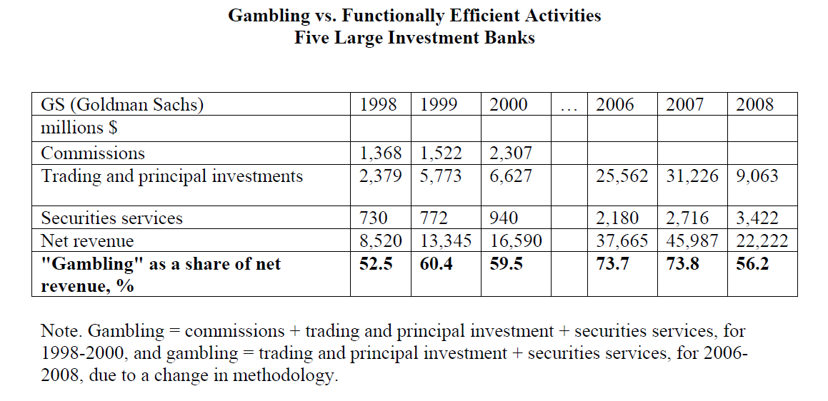
Income From Prop Trading:Prop Trading at Goldman Sachs
Source: Crotty, Epstein, Levina, SAFER, 2009

Slide 9
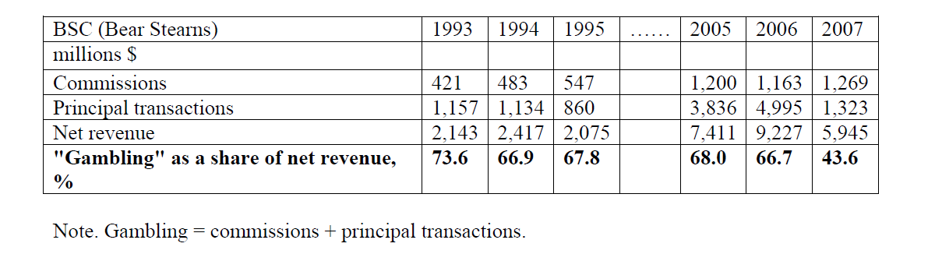
Income from Prop Trading: Bear Stearns

Slide 10
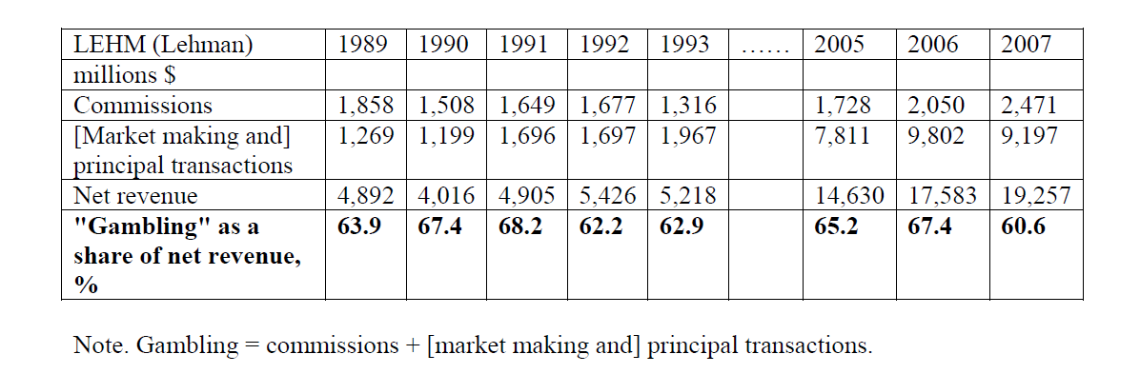
Lehman

Slide 11
It is crucial to use language in the Volcker Rule Intended to investigate whether even permitted activities should be prohibited due to the risks they raise for over-all financial stability.

Slide 12
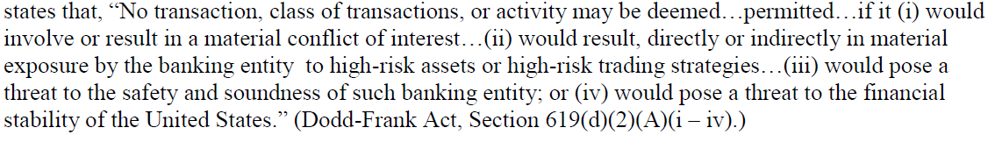
Volcker Rule

Slide 13
Take “Market Making”, for example
Under “market-making”, new, toxic products can be designed and then customers are sought out to buy them.
This is not “market-making” in the sense that there is a body of prior customers seeking a market in particular products.
In true market making, the revenue would be gleaned primarily from bid-ask spreads

Slide 14
Financial Stability Considerations suggest:
Careful and prior scrutiny of products that ostensibly serve to make markets in this sense.
To carefully study the funding mechanisms for such market facilitation. Liquidity and maturity mismatch concerns have to accompany a Volcker Rule implementation that implement the law and place importance on financial stability.

Slide 15
Stifle Financial Innovation?
Critics will claim that such strict application of financial stability concerns will stifle financial innovation.

Slide 16
Financial Innovation: beyond the ATM?
Volcker was right: the surveys of financial innovation cannot find link between financial innovation and economic growth

Slide 17
Empirical Estimates of impact of Financial Innovation on Growth, Productivity
White and Fame 2004 JEL survey article:
“Very little empirical evidence on the impact of financial innovation”.

Slide 18
Studies of New Security Issues
Motives for Financial innovation (Finnerty, Tobin, et. al):
(1) reallocating risk
(2) increasing liquidity
(3) reducing agency costs
(4) reducing transactions costs
(5) reducing taxes
(6) circumventing regulatory constraints
(7) gaining first mover-advantages
(8) open new venue for speculation (casino motive)
(9) redistribute income from other stakeholder or customer

Slide 19
Motivations for Financial Innovation
Finnerty Studies
Study | Total Number of Security Innovations (1) | Number motivated at least partly be tax or regulatory reasons (2) | Percentage of total innovations motivated by tax or regulatory reasons (2)/(1) x 100 (%)
Finnerty, 1988 | 103 | 45 | 44
Finnerty, 1992 | 65 | 21 | 34
Finnerty and Emery, 2002 | 80 | 25 | 31

Slide 20
Conclusions:
Risky Proprietary Trading involves very serious systemic risk concerns
Even “permitted activities”, such as “market-making activities” must be intensively scrutinized to limit or place higher capital charges and liquidity limits in order to protect tax-payers and workers from the massive costs of new failures.

